Slide 1

Types Of Fluid Flow:-
Steady & Unsteady Flows.
Uniform & Non-uniform Flows.
Laminar & Turbulent Flows.
Compressible & Incompressible Flows.
Rotational & Irrotational Flows.
One , Two & Three Dimensional Flows.

Slide 2
Steady & Unsteady Flows:-
Steady Flows:-
In which the fluid Characteristics Like velocity, pressure, density , etc. At a Point do not change with time.

Slide 3
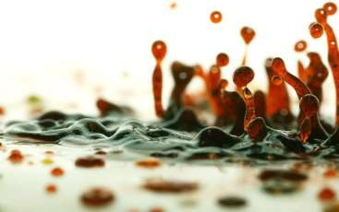
Unsteady Flow:-
In which the fluid velocity , pressure or density at a point changes with respect to time.

Slide 4
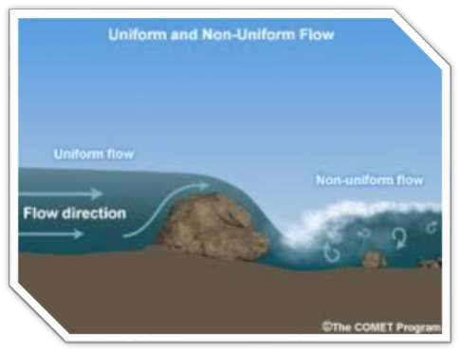
Flow :-
Uniform & Non-uniform
Uniform Flow:-
In which the velocity at given time does not change with respect to space ( length of direction of the flow ).

Slide 5
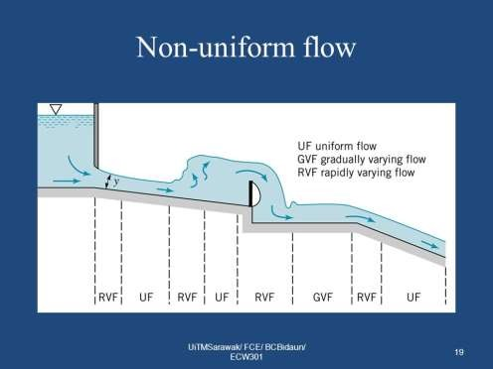
Non-Uniform Flow:-
Changing in space
In which the velocity at any time changes with respect to space.

Slide 6
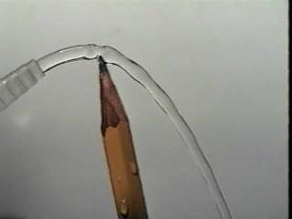
Laminar & Turbulent
flows:-
Laminar Flow:-
 in which the fluid particles move along well defined paths or stream line.
Fig. Laminar Flow

Slide 7
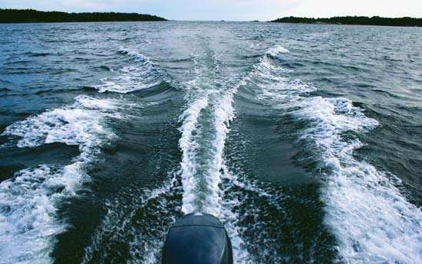
Turbulent Flow:-
fluid moves in very irregular paths or zig – zag Way.
velocity at a point fluctuates.

Slide 8
Compressible & Incompressible Flows:-
Compressible Flows:-
In which the density of the fluid changes from point to point.
The density is not constant for the fluid.
Incompressible Flows:-
In which the density of fluid changes from point to point.
the density is constant for the fluid.

Slide 9
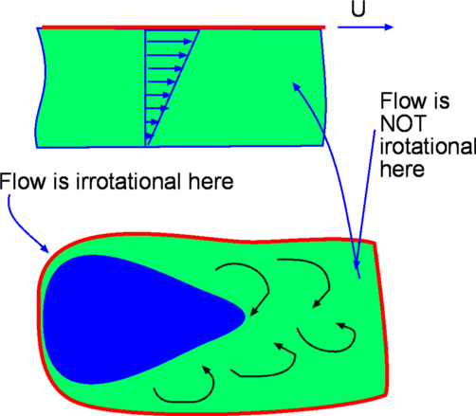
Rotational & Irrotational Flows:-
Rotational Flow :-
In which the fluid particles while flowing along stream lines, Also rotate about their own axis.
Irrotational Flow:-
In which the fluid particles while flowing along stream lines, do not rotate about their own axis.

Slide 10
One Dimensional Flow:-
One , Two & Three Dimensional Flows:-
In which the flow parameter such as velocity is a function of time and
one space co-ordinate only.

Slide 11
Two Dimensional Flow:-
In which the velocity is a function of time and
two rectangular space co-ordinates.

Slide 12
Three Dimensional Flow:-
In which the velocity is the function of time and
Three mutually perpendicular directions.

Slide 13



