Slide 1



The motion of Real fluids is very complicated and STILL not fully understood. So… We will only analyze Ideal fluids.
In an Ideal fluid, the flow is …
turbulent
1. Steady (or laminar): The velocity (speed and direction) of the fluid at any given point does not change. Example: smoke from an extinguished candle changes from laminar to turbulent.
laminar

Slide 2

2. Incompressible: The fluid’s density is constant.
3. Nonviscous: An object moving through the fluid would experience no viscous drag force (i.e. Once set in motion, an object would continue at constant speed through a nonviscous)
Viscosity is the fluid analog of friction between solids, and thus is a measure of the fluid’s resistance to flow.
Syrup and oil are highly viscous fluids

Slide 3
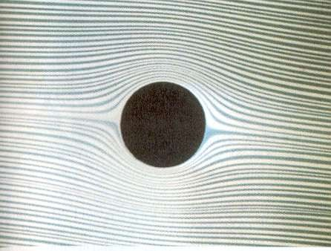
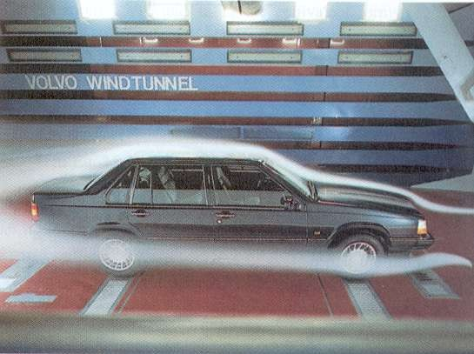
The flow of a fluid can be made visible by adding a tracer, such as a dye to a liquid flow or smoke to a gas flow. Each bit of tracer follows what is called a streamline .
Laminar flow in a liquid around an obstacle
Airflow streamlines for a car in a wind-tunnel test.

Slide 4
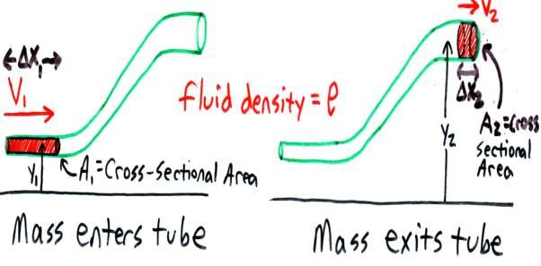


The Continuity Equation – Conservation of Mass
Mass of fluid entering tube in a given time must equal mass of fluid exiting tube…
m₁ m₂

Slide 5





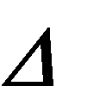



V₁ V₂
A₁ X₁ A₂ X ₂
A₁ v₁ t
(V = Volume in this step)
(Substitute x = …..?)
(v = Velocity in this step)
A₂ v₂ t
A₁ v₁ A₂ v₂
Av Constant
OR…

Slide 6

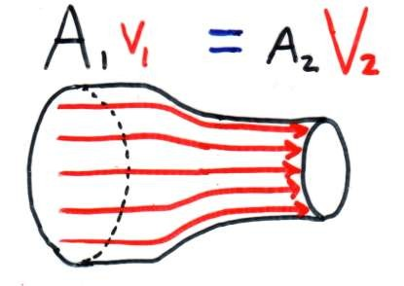

Av Constant
is often called the
“Volume Flow Rate” equation because the term Av is equivalent to Volume/time , with SI
_{m}3
units of
s
↓.
As A ↑, v
As velocity increases, streamlines get closer.
An Application:

Slide 7

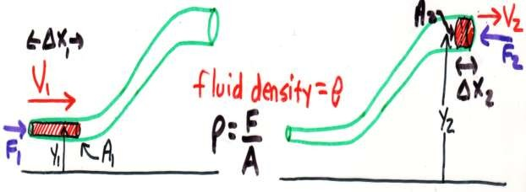




Bernoulli’s Equation – Conservation of Energy
F₁ does positive work…W₁ = F₁
x₁ P₁ A₁ x₁ x₂ P₂ A₂ x₂
F₂ does negative work..W₂= F₂
A₁ X₁
W_{net} = W₁ – W₂ =
A₂ X ₂ V
P₁ V P₂ V

Slide 8


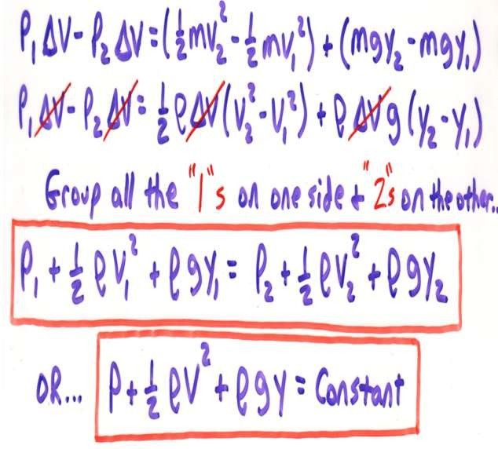
change in energy of the fluid.
The net work on the fluid, then, must equal the
K U
^{W}net ⁼

Slide 9





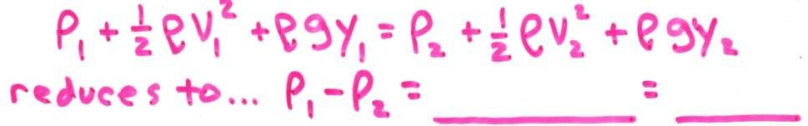



1. Fluids at Rest … V₁ = V₂ = 0_
g y₂ y₁
gh
(Same result as derived earlier for static pressure!)

Slide 10
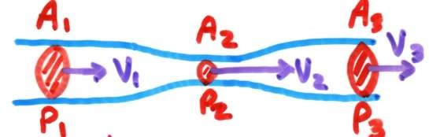
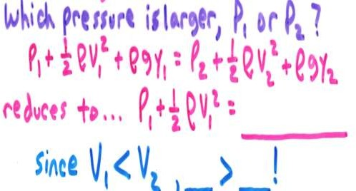


2. Consider a pipe with multiple diameters, but at the same height…
From Continuity Equation..
_{A1}V₁
= ^{A}2 V₂
1
_{v} 2
P
2
2
2
P₁ P₂
So… the pressure of a moving fluid decreases
as its speed increases!!

Slide 11
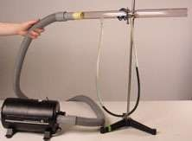
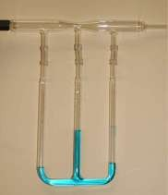
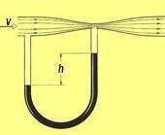
=
Demonstrations
=
We can make sense of this if we think about F = ma…
Fluid speeds up from 1 to 2, so the direction of the net force on the fluid must be to the right
( ^{P}1 > ^{P}2 ).
Fluid slows down from 2 to 3, so the direction of the net force on the fluid must be to the left
( P₂ < P₃ ).

Slide 12
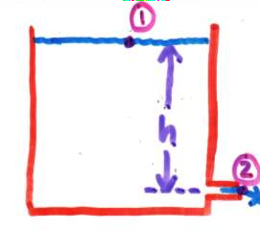

3. A large tank has a small pipe near the bottom. The speed at which a fluid will escape out the pipe can be calculated
using Bernoulli’s Principle…
Apply Bernoulli’s Equation between 1 and 2.
Since 1 is at the surface & 2 is just as the fluid leaves the tank, P₁ & P₂ are both ^{P}a_ absolute pressure or 0 _ gauge pressure (can use either in Bernoulli’s Equation, as long as you are consistent!)

Slide 13



If the tank is large, V₁ ≈ 0
1
2
_{v}2
gh
_{v}2
2gh
y = 0
v 2gh
Same result as for a body
that free falls_ from a
height, h.
Choosing a different 1 produces the same answer… choose point inside tank, a height, h, below the surface.
1
2
_{v}2
gh
If the outlet pipe were redirected vertically, how high
would an ideal fluid rise above the outlet? h !

Slide 14
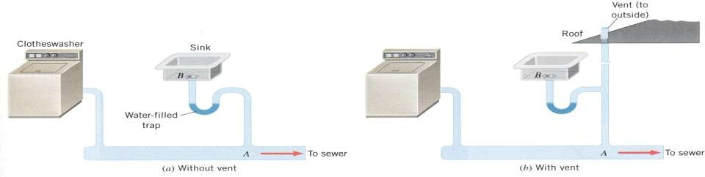
5. Household Plumbing…What is the purpose of the U-shaped pipe beneath a sink called a (“trap”) AND the vent pipe that extends through the roof?
The purpose of the “trap” is to provide a barrier to prevent smelly sewer gases from entering the home. But what would happen, then, if there was no vent?....When water from the clotheswasher would rush through the pipe, the high velocity
water would have a lower pressure than atmospheric
(Bernoulli). Since P_{B} > P_{A}, the water in the trap would be pushed out into the sewer line, allowing those nasty sewer gases to enter your lovely home!!

Slide 15
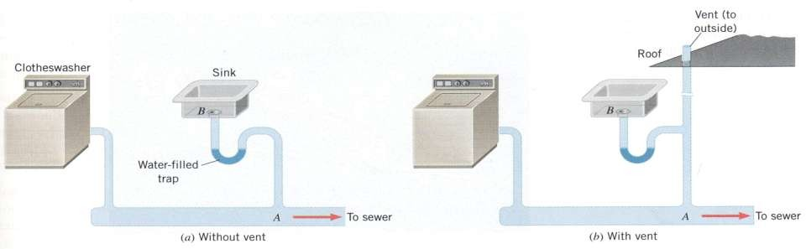
The vent, then, ensures that the pressure on either side of the water-filled “trap” is the same ( atmospheric). So, when the clotheswasher empties its water to the sewer, water will NOT leave the “trap”.
Contrary to popular belief, the purpose of the vent is NOT to provide an escape route for the sewer gas!

