Slide 1
Pressure and its Measurement
Created by : Mr. Akil V. Memon
(M.E. Civil – IWM)

Slide 2
Pressure
Fluid has property that it exerts force on all the sides, top and bottom. Pressure exerted by fluid is given as force per unit area which is as follows:
The SI unit of pressure is newton per square metre (N/m²). This is also known as pascal (Pa).

Slide 3
Pressure Head
In a static liquid , vertical distance from datum line to the free surface of liquid is known as Pressure Head.
P= weight of liquid in the cylinder/ Area of the cylinder base
= w×h×A/A (weight= volume × density, volume=h×A and density =w)
=w×h
If specific gravity of liquid is use then
P= w×s×h
We also know that
P=wh (w= weight density)
P=ρ×g×h (ρ= mass density)

Slide 4
Various Types of Pressure
Atmospheric Pressure:
The air surrounding the earth possess some weight. Due to its weight , the air excert some pressure on the surface of the earth. This pressure is known as atmospheric pressure.
It can be measure by barometer.
Atmospheric pressure is equal to,
760 mm of mercury column
10.3 m of water column
101.3 kN/m²
101.3 kPa
1 bar at sea level at 15∘C

Slide 5
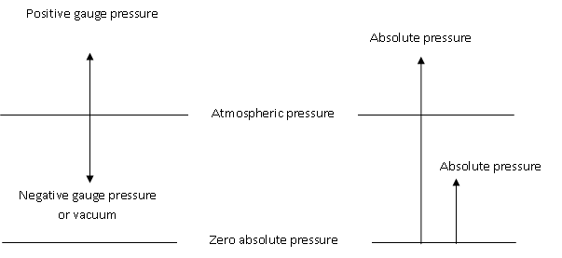
Absolute Pressure:
When pressure is measured with reference to absolute zero pressure it is known as absolute pressure. i.e. absolute zero pressure line is taken as datum.
Gauge Pressure:
When pressure is measured with referece to atmospheric pressure , it is known as gauge pressure (+ve gauge pres.). Bourdon tube pressure gauge measures GP.
Vaccum Pressure:
When pressure is measured with reference to atmospheric pressure, but it is below atmospheric pressure, it is known as vaccum pressure(-ve gauge pre.). Berometer measures VP.

Slide 6
Pressure Measuring Equipment's:
PME
Manometers
Mechanical Gauges
Piezometer
Simple U-tube mano.
Differential U-tube..
Inverted U-tube..
Bourdon tube Press. gauge
Diaphragm gauge
Bellows gauge
Dead weight gauge

Slide 7
Piezometer
A piezometer is the simplest form of the manometer.
It measures gauge pressure only.
The pressure at any point in the liquid is indicated by the height of the liquid in the tube above that point, which can read on the calibrated scale on glass tube.
It consist of a tube, one end of which is connected to pipeline in which pressure is required to be found out. The other end is open to the atmosphere, in which liquid can rise freely without overflow. The height to weight the liquid rises up in the tube gives pressure head directly.
The pressure at point A is given by;
𝑝 = 𝜌𝑔ℎ = 𝑤ℎ
Therefore h= p/ 𝜌𝑔

Slide 8
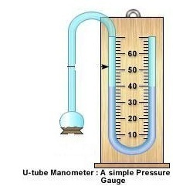
Simple U-tube Manometer
It is an improved form of a piezometer.
It consist of a tube bent in u- shape, one end of which is attached to the gauge point and the other is open to the atmosphere.
Heavy liquid like mercury (s= 13.6) is filled in the u-tube. It is also known as manometric fluid.
Due to pressure of liquid in the pipeline, mercury is displaced in the u-tube.
Displacement of mercury is measured in terms of head h1 and h2.
It can be used to measure high pressure and negative pressure.

Slide 9
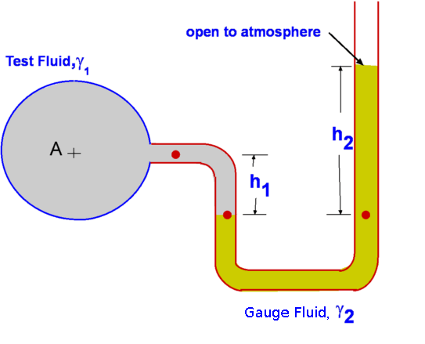
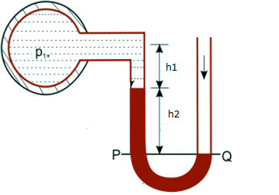
For Positive pressure
$\frac{P_{A}}{ρ×g}+s_{1}h_{1}−s_{2}h_{2}=0$
$\frac{P_{A}}{ρ×g}=−s_{1}h_{1}+s_{2}h_{2}$
h$=−s_{1}h_{1}+s_{2}h_{2}$
For Negative pressure
$\frac{P_{A}}{ρ×g}+s_{1}h_{1}+s_{2}h_{2}=0$
$\frac{P_{A}}{ρ×g}=−s_{1}h_{1}−s_{2}h_{2}$
h$=−s_{1}h_{1}−s_{2}h_{2}$

Slide 10
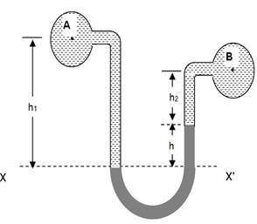
Differential U- tube manometer
Let the two points A and B are at different level and also contains liquid of different specific gravity. These points are connected to the u-tube differential manometer.
Pressure head in the left limb above datum = $h_{A}+s_{1}h_{1}$
Pressure head in the right limb above datum = $h_{B}+s_{2}h_{2}+s.h$
Since pressure head in both the limbs above the datum are equal
$∴h_{A}+s_{1}h_{1}$= $h_{B}+s_{2}h_{2}+s.h$
$h_{A}$-$h_{B}$ =$s_{2}h_{2}+s.h−s_{1}h_{1}$
Heavy liquid like mercury is used to fill in the u –tube.

Slide 11
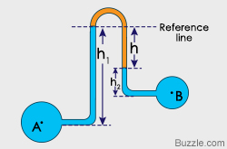
Inverted U-tube Manometer
Pressure head in the left limb above datum = $h_{A}−s_{1}h_{1}$
Pressure head in the right limb above datum = $h_{B}−s_{2}h_{2}−s.h$
Since pressure head in both the limbs above the datum are equal
$∴h_{A}−s_{1}h_{1}$= $h_{B}−s_{2}h_{2}−s.h$
$h_{A}$-$h_{B}$ =${−s}_{2}h_{2}−s.h+s_{1}h_{1}$
Light liquid is used as manometric fluid

Slide 12
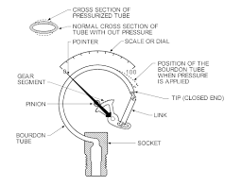
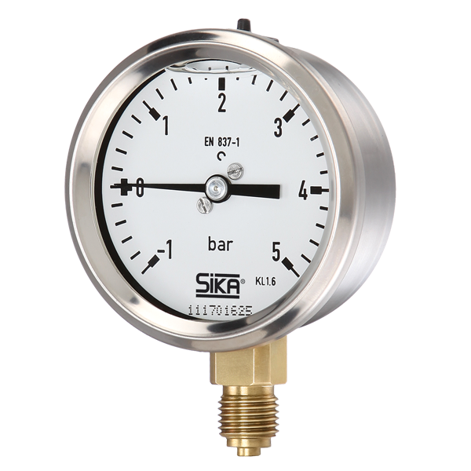
BOURDON TUBE PRESSURE GAUGE
The components of bourdon gauge are bourdon tube , sector, pinion, dial gauge , pointer
The bourdon pressure gauge is suitable for measuring not only high pressures such as those in a steam boiler or a water main but also negative or vaccum pressures. A gauge which is so devised to measure positive as well as negative pressures is called a compound gauge.

